Slide 1
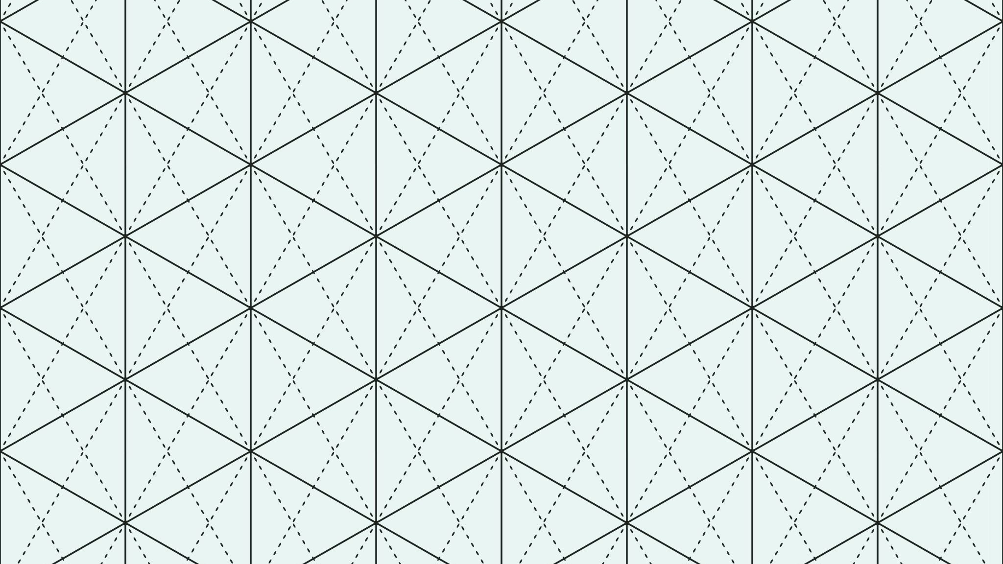
Adsys Interview Presentation
By Varun Pradhan

Slide 2
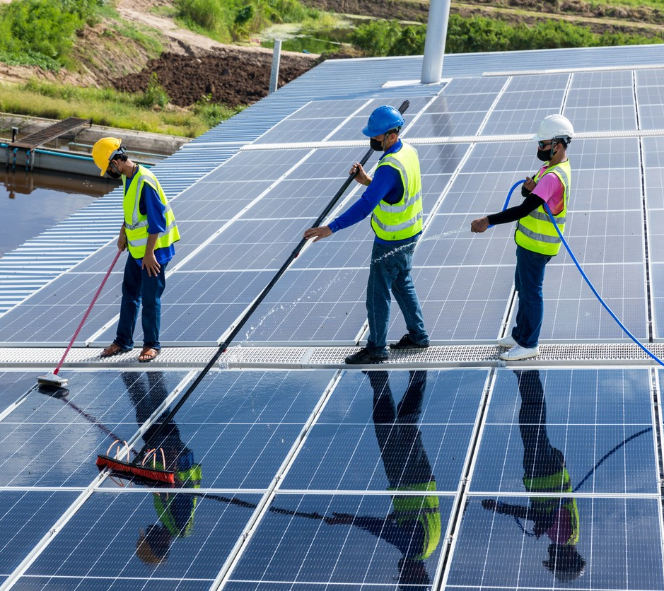
Introduction
It is well known that dirt and residue on solar panels significantly reduces the efficiency of solar cells.
Consequently, solar panels need to be cleaned on a regular basis. Regretfully, maintaining solar panels is an arduous undertaking that frequently necessitates technicians to scale rooftops in order to reach solar panels, thereby augmenting the risk of accidental falls.
Thus, the need for equipment that can solve this issue is urgent.

Slide 3
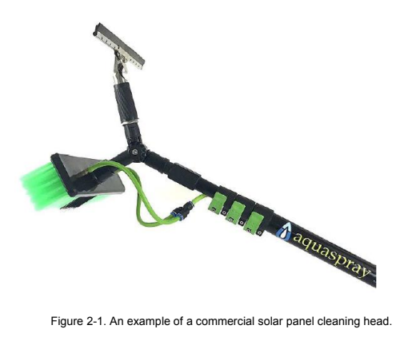
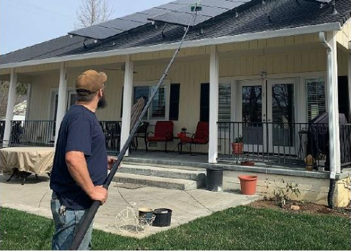
Problem Definition
Solar panel cleaning can be accomplished with a variety of tools that are readily available on the market, including cleaning heads that have a brush, squeegee, and water spray (see Figure 2-1).
However, using a long pole to reach a solar panel diagonally is frequently not possible when accessing solar panels from a property with limited space surrounding the structure (see Figure 2-2).
In an effort to raise the overall efficiency of residential solar energy generation, an inventive articulated extension arm (AEA) that can utilize current solar panel cleaning heads is therefore required to safely and consistently clean solar panels.

Slide 4
Implementation
Based on the requirements listed in Table 2-1, three concepts for the AEA were analyzed(see Figures 3-1, 3-2, and 3-3). The first concept (Figure 3-1) is based on using a simple mechanism with two sliding tubes that can be controlled using ropes/strings. One rope pulls the outer tube downward.
While a second rope is snaked through the inner tube and attaches to the upper end of the outer tube. Pulling this rope, pulls the outer tube upward. The cleaning head assembly is attached to the outer tube.
Concepts 2 and 3 are based on a pulley mechanism as shown.

Slide 5
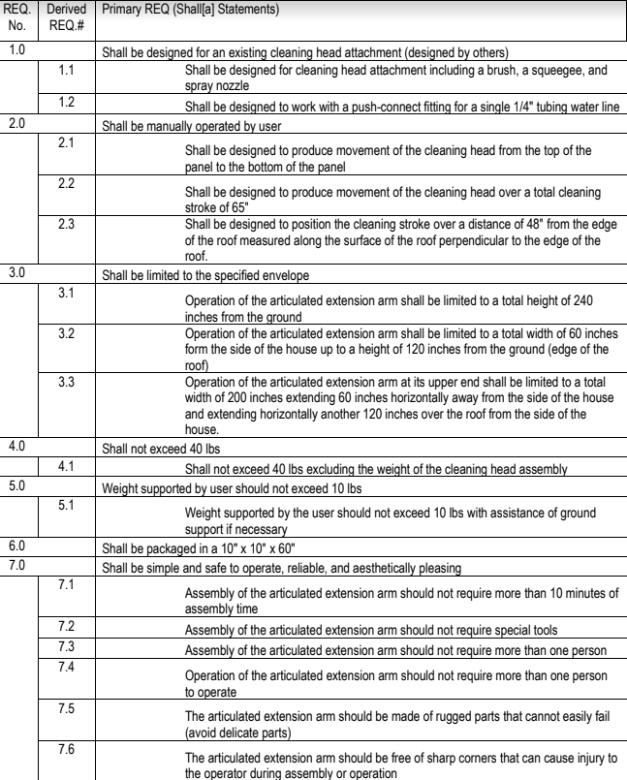
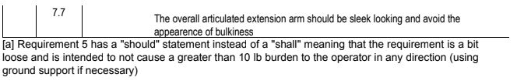
Table 2-1: AEA Requirements Table

Slide 6
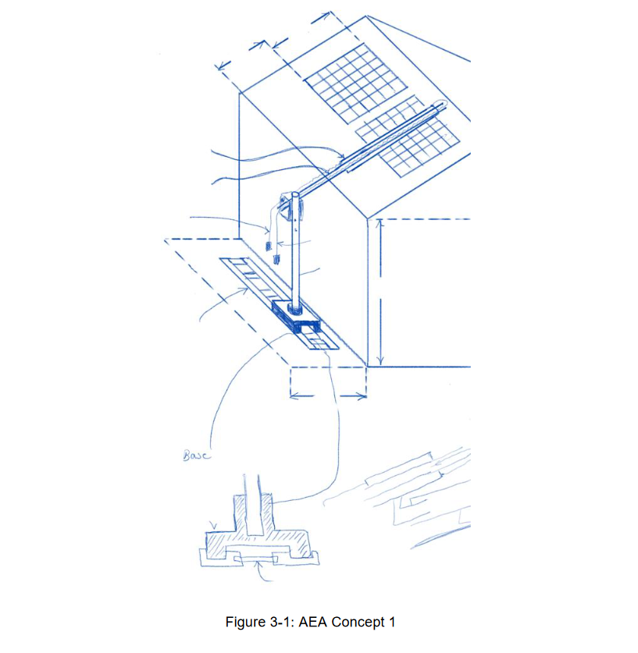
Concept 1

Slide 7
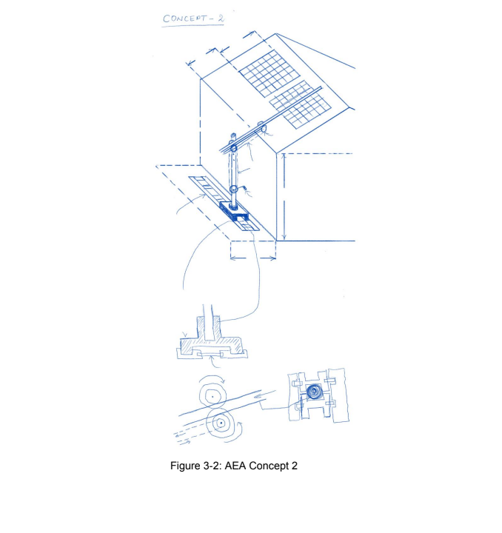
Concept 2

Slide 8
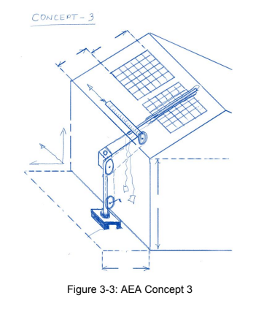
Concept 3

Slide 9
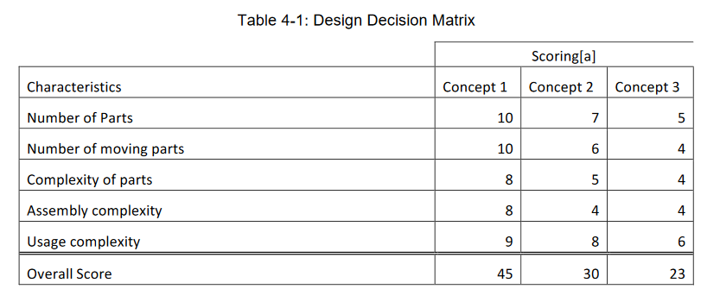
Concept Selection
Table 4-1 is a design decision matrix based on attributes of the three design concepts. As you can see, Concept 1 is a clear winner therefore this was selected.
([a] Score = 1-10 point scale; 10 Favoring selection of the concept)

Slide 10
Embodiment Design
Figure 5-1 shows a first “quick and dirty” Solidworks model to evaluate the feasibility.
Figure 5-2 shows an exploded view of this design
The next two slides will display a CAD/CAM display of these figures.

Slide 11
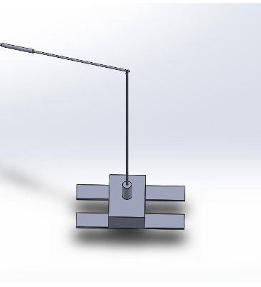
Figure 5.1 CAD

Slide 12
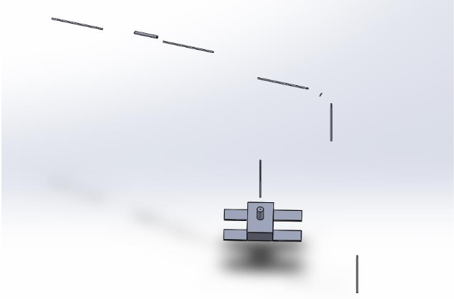
Figure 5.2 CAD

Slide 13
Summary & Conclusion
Model was designed such that no individual part is longer than 60 inches so that all parts fit in a packaging of 10 in x 10 in x 60 in.
At the first layer, it looks like a feasible design with simplicity and ease of use as its main advantages.

